Slide 1
Windsor’s Quest
Christopher Clark, Cedric Crawford
Morgan Channell, Raymond Chui

Slide 2
Game Concept
2D Aerial View Dungeon Crawler
Inspired by The Legend of Zelda game series
Game Story
Player Character: Windsor
Brought to a strange new world
Magical Familiars
Current Demo
Navigating first dungeon
Familiars: Snake, Pigeon
Weapon: Sword

Slide 3
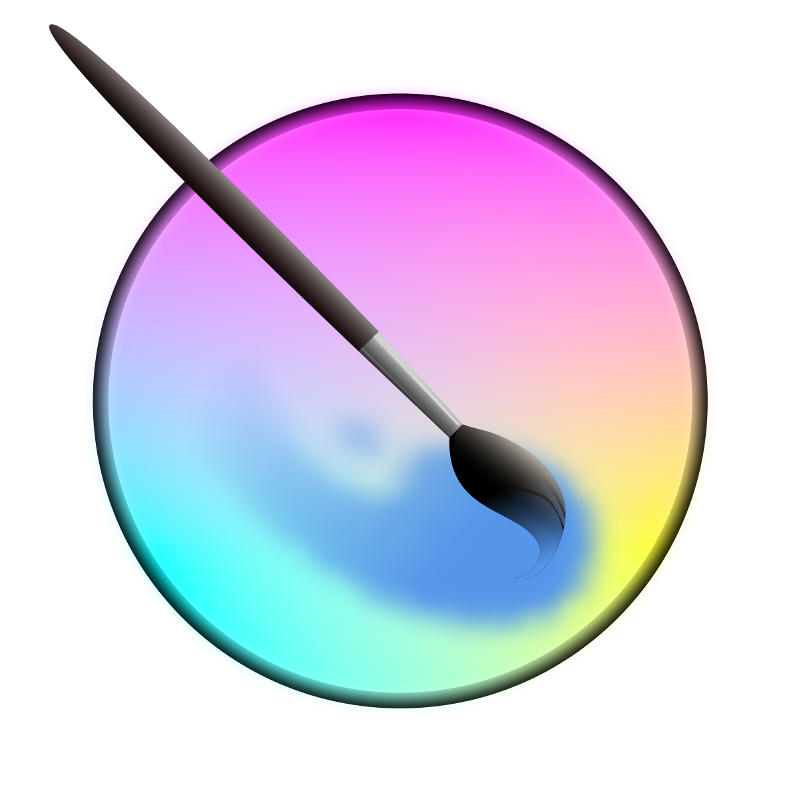


Tools Used
Krita
Art Production
Git from Github
Project Organization
Version Control
Godot
Game Engine
Code Implementation

Slide 4
Godot Game Engine
Separate 2D & 3D graphics engines
We used 2D
Free Open Source
Cross-Platform between Linux, Windows, MacOS
GDScript
Internal scripting language
Portable
Python styled
Optimized for game scripting

Slide 5
Development Phases
First Phase – Game Concept
Second Phase - Art requirements
PNG Format
Animation frames
Third Phase – Code Prototyping
Fourth Phase – Code Structuring & Global Resources
Fifth Phase – Final Code Design & Unit Testing

Slide 6
Project Structure
Global Scripts
Contains most reusable code
Global.gd and Damage.gd
Scenes
Design of objects
Contains attached scripts
Un-instanced and reusable
Sprites
Contains all artwork used

Slide 7
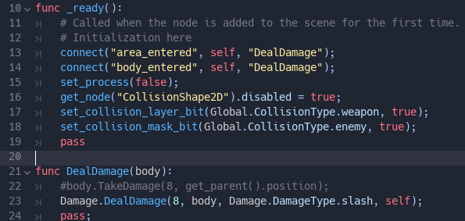
Global Damage Example Player Sword Collision

Slide 8
Future Features
More Dungeons, Items, and Enemies
Explorable Over-world
More in-depth plot
Character dialogue
More advanced item systems
Puzzles
Music and Sound FX

